Slide 1
Power to the Profession
Minnesota P3 Design Team
April 13, 2017

Slide 2

National / Mn Association for the Education of Young Children
NAEYC / MnAEYC promotes high-quality early learning for children, birth through age 8, by connecting practice, policy, and research.
We advance a diverse, dynamic early childhood profession and support all who care for, educate, and work on behalf of young children.

Slide 3
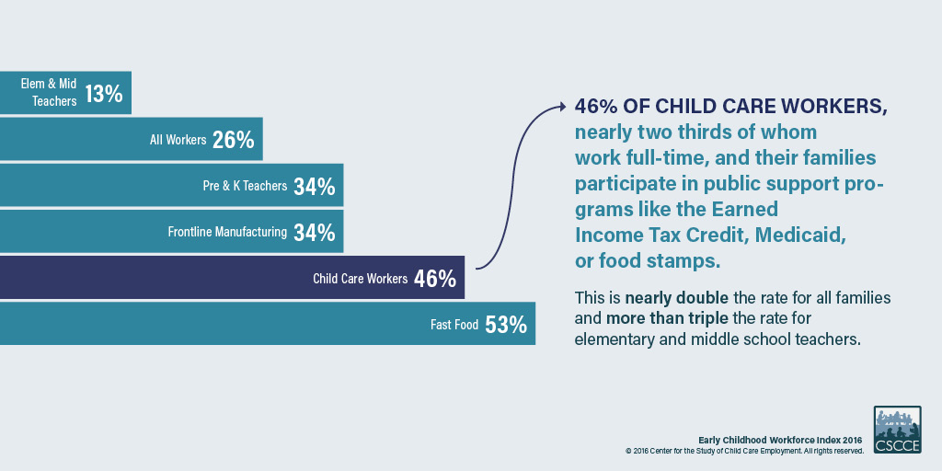
State of the Early Childhood Workforce

Slide 4
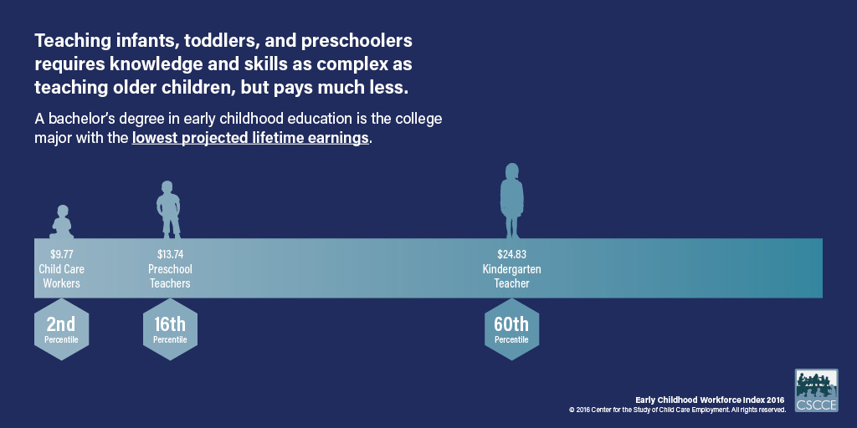
State of the Early Childhood Workforce

Slide 5
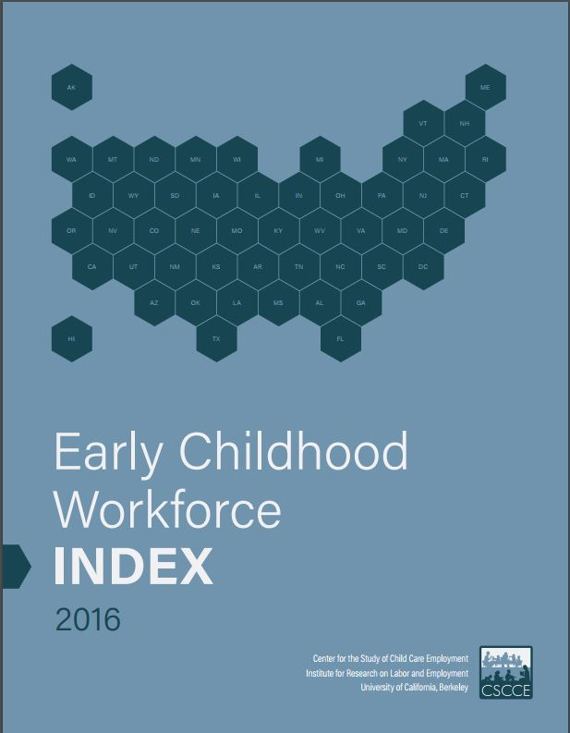
State of the Early Childhood Workforce
Center for the Study of Child Care Employment
Early Childhood Workforce Index
www.cscce.Berkeley.edu

Slide 6
Should all these teachers be expected to perform at the same level?
Teacher A | Teacher B | Teacher C | Teacher D | Teacher F
24 Training Hours Certificate | Child Development Associate Credential OR State child care credential | Associate Degree in Early Childhood Education, Child Development or a related field | Bachelor’s Degree in Early Childhood Education, Child Development or a related field | Higher education degree in Early Childhood Education with State Teaching Licensure (Birth to 3rd Grade; public schools)

Slide 7
Who should be paid as much as a 3rd grade teacher?
Teacher A | Teacher B | Teacher C
Young children are safe and fed | Young children are safe and fed AND Young children are able to play with lots of toys and books | Young children are safe and fed AND Young children have experiences and interactions that are intentionally facilitated to support their development

Slide 8

Seize the Moment
Early childhood work is critical
Early childhood work requires complex thinking
Early childhood work requires specialized training and education
Investments must be made to support the profession

Slide 9
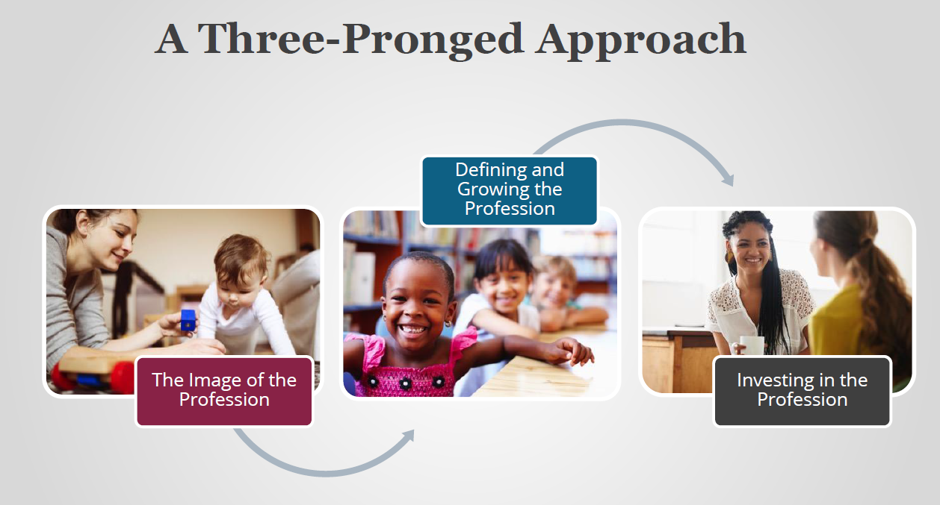
Power to the Profession
Power to the Profession

Slide 10
Power to the Profession:
Goals
Establish a shared framework of knowledge and competencies, qualifications, standards of practice, and compensation that unifies the entire early childhood education profession, ages birth through 8, across all settings
Develop a comprehensive policy and financing strategy for the systemic adoption and implementation of the shared framework

Slide 11
Power to the Profession:
Timeline
2016: Conceptualization and capacity building
2017-18: Developing the shared framework and policy strategy
2019: Policy adoption and implementation

Slide 12
How do we get there?
Structure
Affiliates & Members
Bring the voices of the field into the national conversation
Task Force
15 National Organizations who represent & engage with large groups of ECE professionals
Stakeholders
30 National Organizations with system-level influence

Slide 13
Task Force
American Federation of State, County and Municipal Employees
American Federation of Teachers
Associate Degree Early Childhood Teacher Educators
Child Care Aware of America
Council for Professional Recognition
Division for Early Childhood of the Council for Exceptional Children
Early Care and Education Consortium
National Association for Family Child Care
National Association for the Education of Young Children
National Association of Early Childhood Teacher Educators
National Association of Elementary School Principals
National Education Association
National Head Start Association
Service Employees International Union
ZERO TO THREE
Notes:
Lead the development of the shared framework
Actively engage networks for input to drafts
Promote and elevate Power to the Profession
Advocate for the shared framework as a strategy to advance the profession

Slide 14
Stakeholders
American Association of Colleges for Teacher Education
American Indian College Fund
BUILD Initiative
Center for American Progress
Center for the Study of Child Care Employment
Center on Enhancing Early Learning Outcomes
CLASP
Council for the Accreditation of Educator Preparation
Council of Chief State School Officers
Data Quality Campaign
Early Childhood Personnel Center
First Five Years Fund
JumpStart
McCormick Center for Early Childhood Leadership
Military Child Education Coalition
National Academy of Sciences
National Association of Early Childhood Specialists in State Departments of Education
National Association of State Boards of Education
National Black Child Development Institute
National Board for Professional Teaching Standards
National Council of La Raza
National Governors Association
National Institute for Early Education Research
National League of Cities
National Women’s Law Center
National Workforce Registry Alliance
New America
Ounce of Prevention Fund
Save the Children
TEACH Early Childhood National Center
Teach for America
Notes:
Respond to working drafts and give input
Drafts sent to stakeholders before being sent to broader field
Webinars recorded during initial comment period
Propose measures related to policy adoption
Serve as a leader and influencer in promoting the shared framework
Partner on the ground for community events

Slide 15
Core Components of a Profession
1. Name
2. Distinct role in society
3. Distinct responsibilities
4. A Code of Ethics
5. Expectations and standards for practice
6. Competencies
7. Educational requirements for professional entry
8. Examination or assessment requirements for professional entry
9. Experience, practicum, or clinical requirements for professional entry
10. Accreditation of Professional Preparation Programs in Higher Education Institutions or Other Approved Sources (connected to #7)
11. Government agency that issues license to practice (Initial and Renewal)
12. Government agency that penalizes licensed professionals who violate professional norms or threaten public safety

Slide 16
How do we get there?
8 Decision Cycles - (January 2017 – December 2018)
Professional Identity and Boundary
  Advancing, Influencing & Governing vs. Influencing & Partnering
2. Competencies (General)
  Know, Understand, Demonstrate
3. Competencies (Specialized)
  Know, Understand, Demonstrate
4. Competency Attainment Source
  IHEs and non-IHEs where competencies can be earned
5. Qualifications and Pathways
  3-4 Levels of Mastery
6. Compensation Recommendation
  Recommendation Per Level of Mastery
7. Required Accountability and Quality Assurance
  Certification (Eligibility and Exam)
  Approved Competency Attainment Source (IHEs and non-IHEs)
8. Required Support and Infrastructure
  Educator, Higher Education, Program, State, Association
Transition to Finalizing and Implementing
Policy and Financing Agenda

Slide 17
How do we get there?
8 Decision Cycles
1. Deliberation with Task Force
2. Review and Feedback*
5. Task Force approves Final Definition
3. Analyze Feedback and Implementation Analysis
4. Round 2 Review and Feedback*
* Stakeholders and experts, including the field via webinar, surveys and online comment period

Slide 18
Engaging the Field:
NAEYC Affiliates
All Affiliates
  Promote NAEYC-produced surveys to members
  Newsletters and communications
  Hold Community Forums
  Make part of conferences
Deep Dive Affiliates
  Currently 5: New York State AEYC, Indiana AEYC, Iowa AEYC, WECA (Wisconsin), New Mexico AEYC
  Key informant interviews, focus groups, community forums

Slide 19
Engaging the Field:
NAEYC Affiliates
What is happening in other states with more than one Workforce Initiative?
What should this look like in MN?
Roles and Collaboration?
Resourcing?

Slide 20
Workforce Initiatives
Organization | States | Goal
NAEYC | New York, Indiana, Iowa, Wisconsin, New Mexico | Community engagement of the field to inform the Power to the Profession discussion and lay foundation for future policy push
National Governor’s Association | Alabama, Iowa, Minnesota, New Jersey, New York, Utah, Washington | Leverage workforce investment resources and strategies to strengthen the quality of early care and education workforce
National Academy of Medicine | California, Illinois, Virginia, District of Columbia region, Washington Nebraska, Minnesota, Colorado | State-specific plans for implementing Transforming the Workforce for Children Birth to Age 8 recommendations
Additional state projects lead by: Child Care Aware of America, TEACH National Center, Center for the Study of Child Care Employment, New America, National League of Cities, National Association for State Boards of Education

Slide 21
Engaging the Field:
NAEYC Affiliates
Discussion
What should this look like in MN?
What have we done so far?
What / how can we learn from other states?

Slide 22
Engaging the Field:
NAEYC Affiliates
Discussion
Roles and Collaboration
Resourcing
Next Steps

Slide 23
Opportunity for Partnership
Sign up for updates: www.naeyc.org/profession
Respond to working drafts and give input
Advise on measures related to policy adoption
Serve as a leader and influencer in promoting the shared framework
Partner on the ground with MnAEYC for community events
Become a Member of MnAEYC

Slide 24
Thank you
Katherine Kempe
Senior Director, Professional Recognition and Advancement
kkempe@naeyc.org
202-350-8867
www.naeyc.org/profession
Kathleen O’Donnell
Executive Director, MnAEYC-MnSACA
kathleeno@mnaeyc-mnsaca.org
651-789-3585
www.mnaeyc-mnsaca.org

